Slide 1
Large Language Models and Authentic Assessment: a Perspective from Legal Education SRHE Roundtable 2023
Dr Stergios Aidinlis – Lecturer in Law – Keele University

Slide 2
Overview
LLMs and (Legal) Education: friend or foe?
LLMs and Traditional Legal Assessment
An authentic and reflective assessment design utilizing LLMs in the legal classroom

Slide 3
Assumptions
For this presentation, I will be assuming that LLMs:
Will have connection to the internet (like GPT-3.5/4 via Bing)
Will not create fictional references (unlike GPT-3)
Will improve even more in synthesising complex information from multiple sources

Slide 4
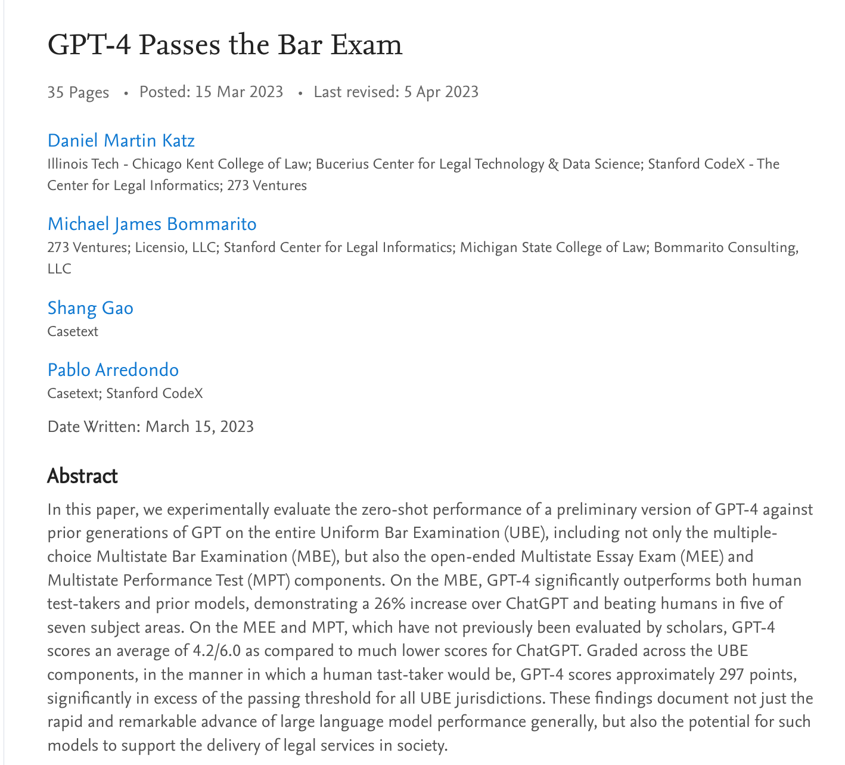
Excitement…

Slide 5
…and fear
Threatening the learning process:
Integrity: may enable students to cheat or plagiarize by generating responses to homework or exam questions without learning the material or citing the sources.
Undermining the feedback function: students miss the critical feedback cycle of doing it wrong in the first time and improving after tutor feedback
Undermining moral reasoning and critical thinking: students learn to rely on ready-made answers based on data found on the Internet, often finding it difficult to challenge their validity and appeal

Slide 6
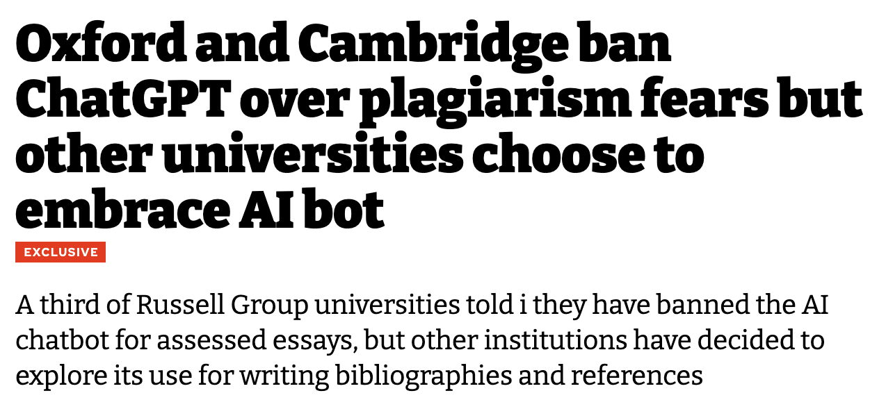
A foe?

Slide 7
Shifting the discourse: an opportunity

Slide 8
Five guiding principles

Slide 9
Death of the lazy assessment?

Slide 10
Death of the lazy assessment?
Assessment that is truly:
Interactive – establishing a constant feedback loop through the use of an interactive technology that is always available to the student
Authentic – cultivating students’ knowledge and skills in ways that are relevant to their lives and future careers
Literacy-focused – seeking to build literacies and transferable skills rather than focusing on concrete knowledge, such as information technology literacy, critical thinking, collaboration and problem-solving

Slide 11
Overview
LLMs and (Legal) Education: friend or foe?
LLMs and Traditional Legal Assessment
An authentic and reflective assessment design utilizing LLMs in the legal classroom

Slide 12
Assessment in law school
Traditional assessment methods:
Essay questions – questions that require the candidate to explain, discuss or comment on the specific legal issues as asked by the examiner. They usually involve a broad topic or a general principle of law that can be approached from different angles and perspectives. Essay questions test the candidate’s ability to demonstrate a deep and critical understanding of the law, as well as their skills in analysis, synthesis and evaluation.
Problem questions – usually involve a hypothetical scenario that contains several legal issues or problems that need to be identified and resolved. Problem questions test the candidate’s ability to apply the law analytically and logically to the facts, as well as their skills in problem-solving, reasoning and communication.

Slide 13
Sources of struggle for LLMs
Specificity – especially in problem questions, there is a need to refer to specific individuals and the legal ramifications of specific actions of (imaginary) individuals in the (fictional) world – LLMs operate better at a level of generality.
Data availability – LLMs have mostly been trained on open-source data and this limits their capacity to analyse complex legal issues which might require the analysis of proprietary data (e.g. a lot of case law in the UK)
Depth of critical analysis – especially in essay questions, there is a need to draw multiple connections to different legal resources, literature views and case law, LLMs not good enough (for now)

Slide 14
Rough structures

Slide 16
Arguments

Slide 18
Overview
LLMs and (Legal) Education: friend or foe?
LLMs and Traditional Legal Assessment
An authentic and reflective assessment design utilizing LLMs in the legal classroom

Slide 19
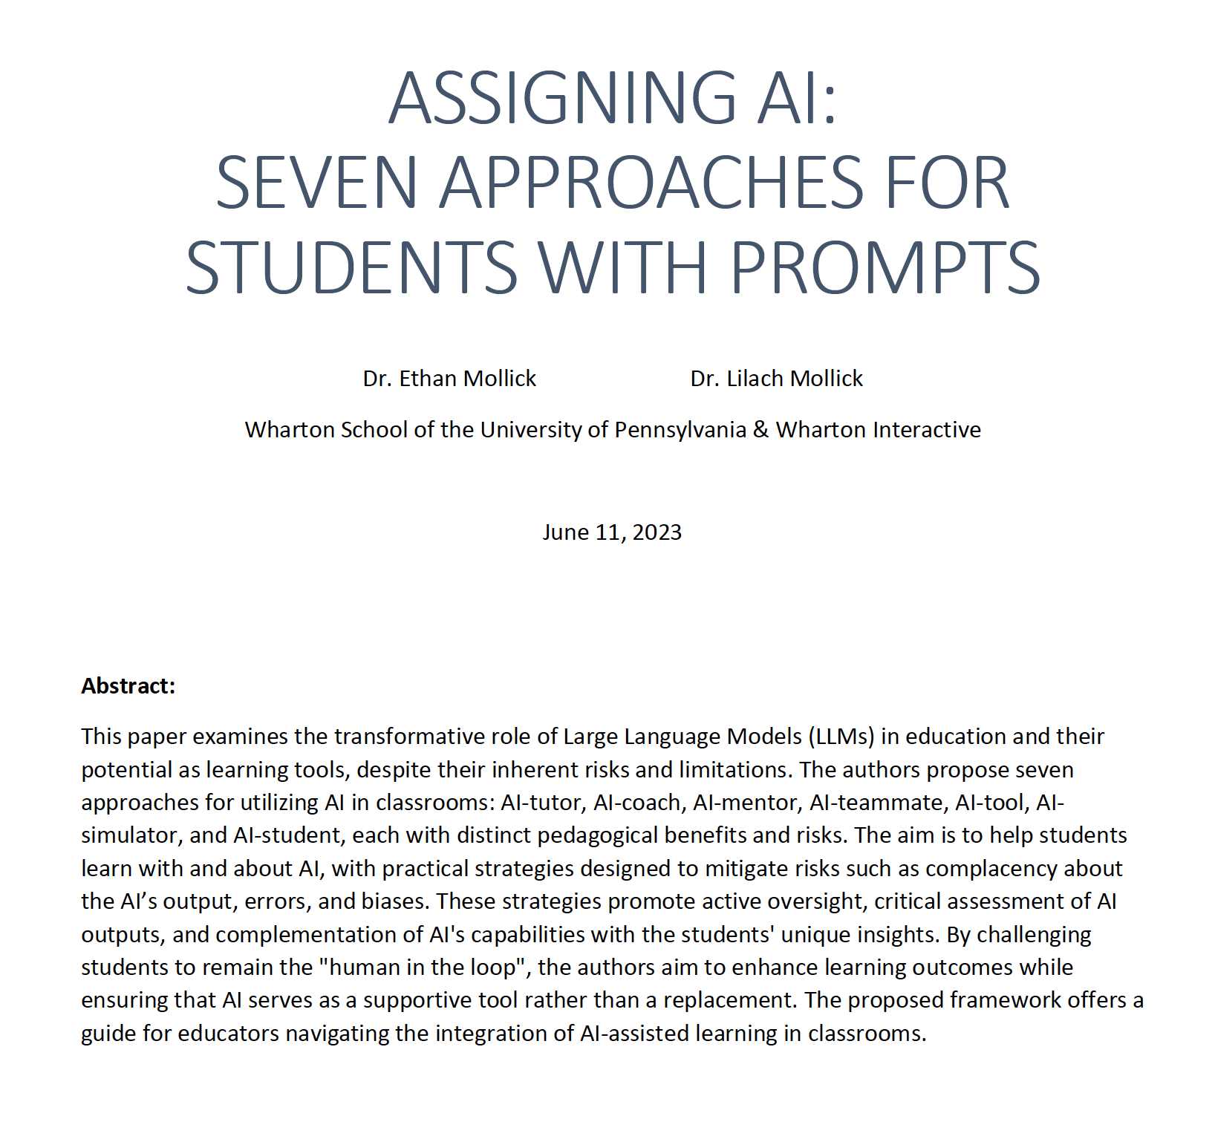
Assigning AI framework

Slide 20
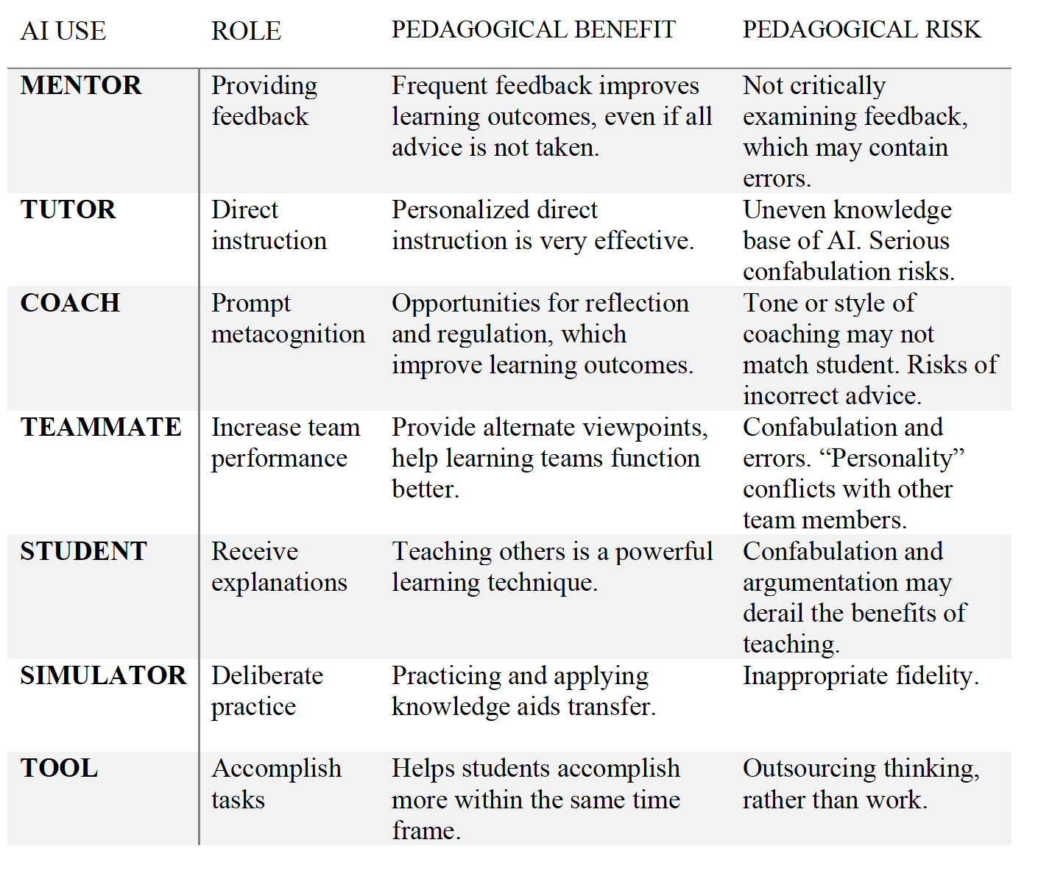

Slide 21
What are we assessing?
Is it the capacity of students to memorise and synthesise information?
How likely are they to exercise this capacity in the real world in the future?
Or is it their capacity to engage and interact with the rapidly changing environment around them and produce topical and technologically informed knowledge?
Idea: take advantage of the conversational and rigour-building capacities of the technology, in prompting students to plan carefully before tackling a legal problem, refining their argument by considering potential objections and recognising the limitations of their position, rather than providing them with a ready-made, often overwhelming for them body of knowledge to use .

Slide 22
Learning with AI in 3 steps
A class-based activity involving:
Preparation before the class (using an LLM to produce a project pre-mortem considering what will be the main challenges in tackling a legal problem)
Use during the class (using an LLM as a mentor to help students solve a legal problem)
Submission of a reflection after the class (using an LLM to reflect on the strengths of the technology and its limitations)

Slide 23
Your tutor, not your essay writer
Explain the purpose and the benefits of using LLMs for legal education. Emphasize that an LLM is designed to help students to improve their legal reasoning and argumentation, not to provide them with ready-made answers or solutions.
Specify the learning objectives and outcomes that students should aim to achieve by using LLMs, and how they will be assessed or evaluated.
Keep track of the progress and the performance of the students who use LLMs, and provide them with constructive feedback on their strengths and weaknesses

