Slide 1
? Generative AI makes imperative the shift from students as consumers to students as producers
Emeritus Professor Angela Brew
Macquarie University, Sydney Australia and Chair of ACUR
What do artificial intelligence systems mean for academic practice. SRHE 19th July 2023

Slide 2
Opportunities, limitations and ethical issues in the GenAI context include
Privacy and data considerations
Potential for bias: e,g. societal biases and stereotypes
Inaccuracy and misinterpretation of information which may produce incorrect, irrelevant or out-of-date information.
Ethics codes may not be embedded within all generative AI tools and their incorporation, or otherwise, may not be something that users can easily verify.
Plagiarism: risk of plagiarised content and/or copyright infringement
Exploitation: the process by which generative AI tools are built can present ethical issues. For example, some developers have outsourced data labelling to low-wage workers in poor conditions . Russell Group principles on the use of generative AI tools in education
Source: Russell Group Principles on the use of generative AI tools in education, July 2023

Slide 3
The democratisation of knowledge production
“The massive increase in the availability of “knowledge” online and the mass expansion of access to university education in developed and developing markets means a fundamental change in the role of universities as originators and keepers of knowledge.” (Justin Boker, 2012, p. 4).

Slide 4
The changing nature of knowledge
“There is a high degree of uncertainty, there is no clear-cut direction but many competing ideas, theories and methods, and no one is in overall charge” Nowotny, Scott and Gibbons, (2001, p. 115) .
Notes:
.

Slide 6
“Inquiry, investigation, and discovery are the heart of the enterprise, whether in funded research projects or in undergraduate classrooms or graduate apprenticeships. Everyone at university should be a discoverer, a learner” (Boyer Commission 1999, p.9)

Slide 7
What do we mean by undergraduate research?
“Undergraduate research scholarship and creative inquiry is fundamentally a pedagogical approach to teaching and learning. With an emphasis on process, CUR defines undergraduate research as: A mentored investigation or creative inquiry conducted by undergraduates that seeks to make a scholarly or artistic contribution to knowledge.” (Council on Undergraduate Research, 2021)

Slide 8
Undergraduate research implementation
Whole University
Scholarship schemes
Whole degrees –PBL, IBL etc
Degree level – 1st year, 2nd year, 3rd year, Honours
Whole units of study/ courses/ modules
Assignments and tutorials within specific units of study or programs

Slide 9
Forms of engagement in undergraduate research
RED: Undergraduate learning – insufficient undergraduate research development
AMBER: Atomistic undergraduate research development – some recognition of the need to develop undergraduate research skills but practice is patchy and coordination across programs requires more work
GREEN: Wholistic undergraduate research – good recognition of the need for coordinated development and integration of students into the scholarly community

Slide 10
ATOMISTIC UNDERGRADUATE RESEARCH DEVELOPMENT:
1. uncoordinated skills development within courses | 2. Coordinated Skills development within courses | 3. Co-curricular research-based scholarly experience/tasters
Essays and reports framed as research. Individual research techniques practiced, e.g. Bibliographical exercises, laboratory techniques, field work, etc. Use GenAI to seek for and learn about different kinds of evidence, awareness of bias; understand the nature of argument/rhetoric | Research techniques are combined and scaffolded through the curriculum. Specific techniques are practiced on unconnected topics. May learn how to complete ethics application and learn about ethical issues | Students work as research assistants, in internships or voluntarily on existing research projects alongside researchers.
Students develop academic skills, knowledge of some techniques but research in the university is unconnected and they are unaware of research and opportunities. They may begin to develop an awareness of different kinds of knowledge | Students develop research techniques. Plan a research project to test something they’ve discovered in GenAI. May lack understanding of relationship to chosen profession | Students are introduced to research life and practices. May be paid a stipend or salary or may gain academic credit
RESULT: Some recognition of need to develop undergraduate research skills
but practice is patchy and coordination across programs requires more work

Slide 11
WHOLISTIC UNDERGRADUATE RESEARCH:
4. Scholarly practice within courses | 5. Co-curricular integration into the scholarly community
Program based to course design, research skills and experiences coordinated so students engage in whole research process | Students work alongside researchers on own projects engaging in whole research process from question setting to publishing. May gain a stipend or academic credit
Students develop a disciplinary professional tool kit with a clear sense of the process of research. They practice skills and use GenAI in a coordinated manner and know how research relates to professional practice | Students are fully integrated into the scholarly community and treated as equal partners with academics. They know how their research furthers the discipline. They are fully capable of understanding and evaluating and making full use of GenAI. They’re aware of ethical and other issues. They have developed a researcherly mindset.
RESULT: Some good recognition of the need for coordinated development and integration of students into the scholarly community.

Slide 12
chair@acur.org.au
angela.brew@mq.edu.au
https://acur.org.au

Slide 13
References
Boker, J. (2012). University of the future: A thousand year old industry on the cusp of profound change. Sydney, Australia: Ernst & Young.
Boyer Commission. (1999). Reinventing Undergraduate Education: A blueprint for America's Research Universities. Stony Brook, NY: Carnegie Foundation for University Teaching.
Brew, A., & Mantai, L. (2017). Academics’ perceptions of the challenges and barriers to implementing research-based experiences for undergraduates. Teaching in Higher Education. 22:5, 551-568 doi: 10.1080/13562517.2016.1273216
Council on Undergraduate Research. (2021). Council on Undergraduate Research Issues Updated Definition of Undergraduate Research. 2021. Available at: https://www.cur.org/council_on_undergraduate_research_issues_updated_definition_of_undergraduate_research/ Accessed 18th July 2023.
Meig, H., Ambos, E., Brew, A., Galli, D. M., & Lehmann, J. (Eds.). (2022). The Cambridge Handbook of Undergraduate Research. Cambridge University Press. DOI: 10.1017/9781108869508
Nowotny, H., Scott, P., & Gibbons, M. (2001). Re-thinking science: Knowledge and the public in an age of uncertainty. Cambridge: Polity Press.
Russell Group. (2023) . Russell Group principles on the use of generative AI tools in education. Available at: russellgroup.ac.uk Accessed 18th July 2023.
Image: 18th century Lecture room of the legal faculty, Leipzig, engraving by Johann Christoph Sysang(1703 - 1757), reproduced at https://www.alamy.com/ Accessed 18th July 2023.

Slide 14
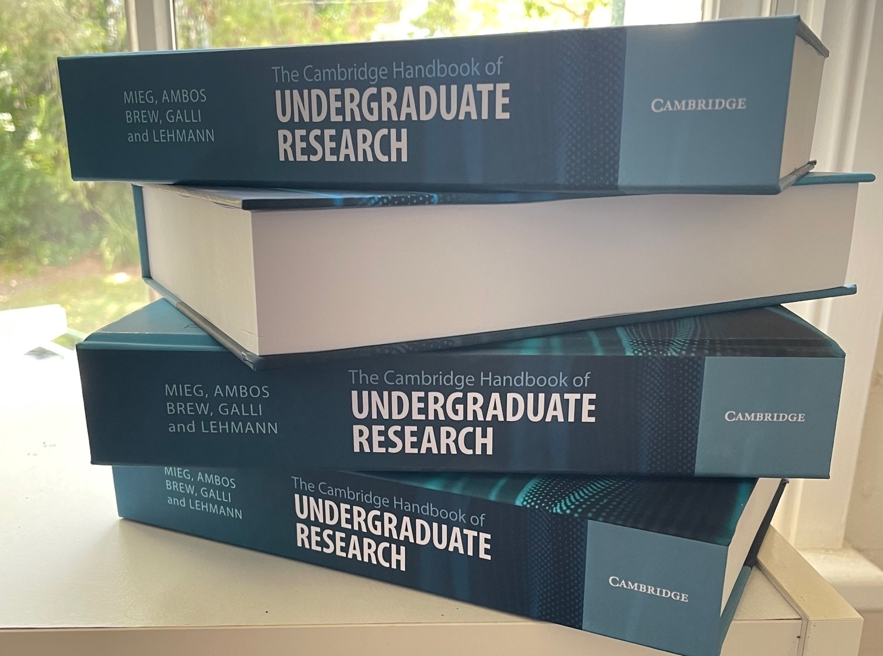
Meig, H., Ambos, E., Brew, A., Galli, D. M., & Lehmann, J. (Eds.). (2022). The Cambridge Handbook of Undergraduate Research. Cambridge University Press. DOI: 10.1017/9781108869508

